Slide 1
Group 8
Thomas Smith and George Davis

Slide 2
Logline and Demographics
Logline – Lean History through Archaeological Excavations
Target Audience – Age 12 to 17

Slide 3
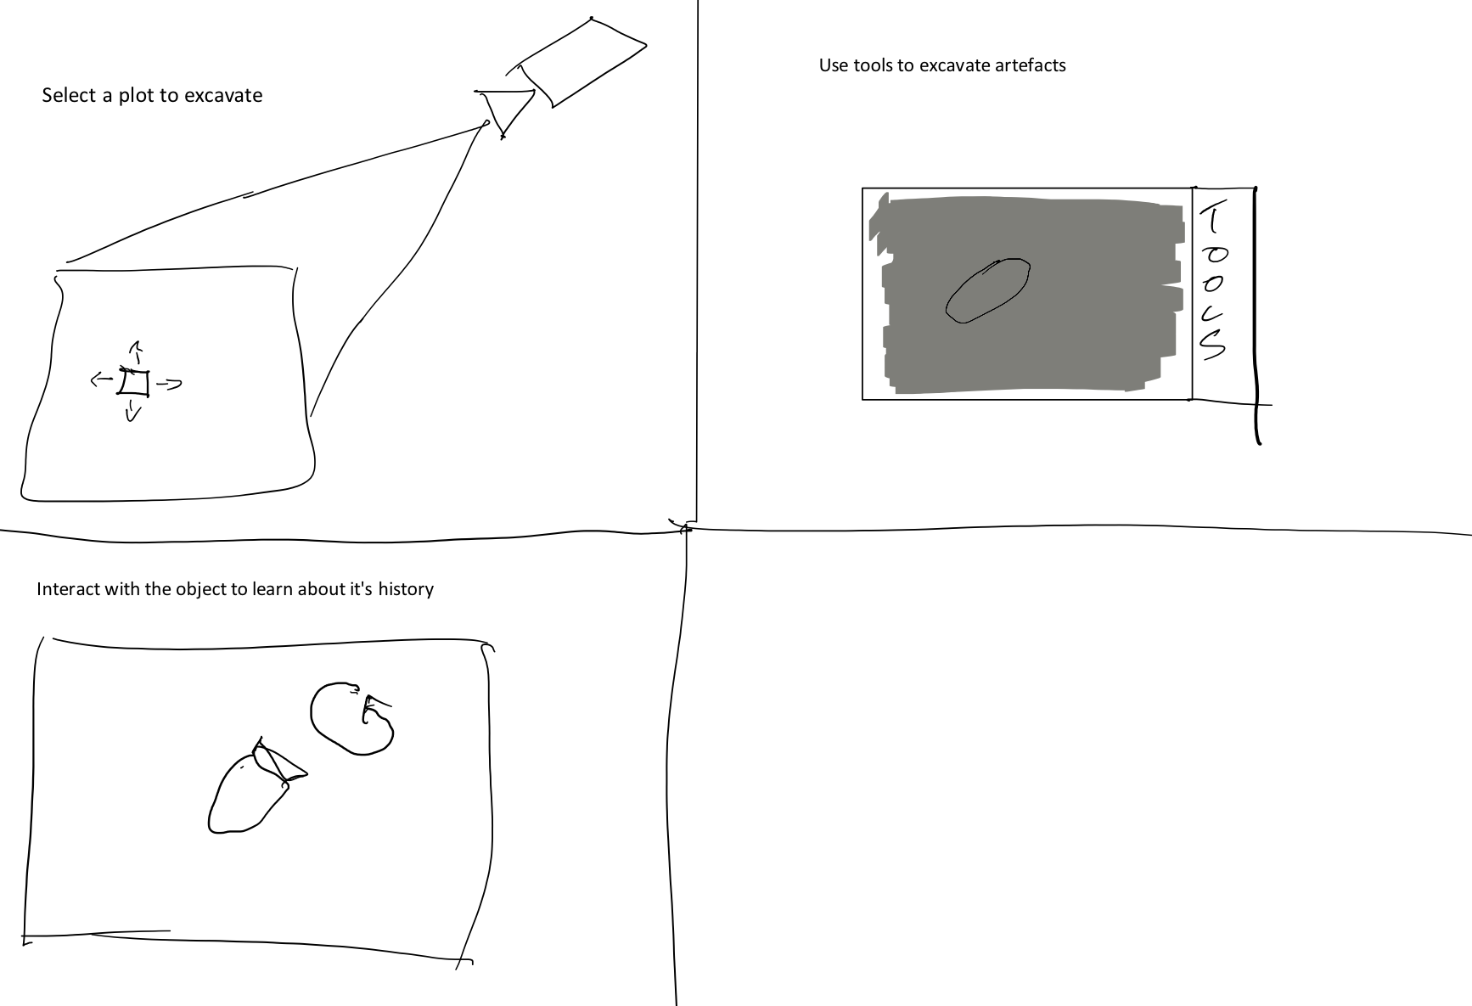
Excavation Diagrams

Slide 4
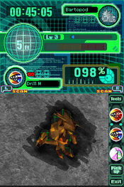
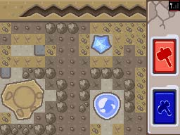
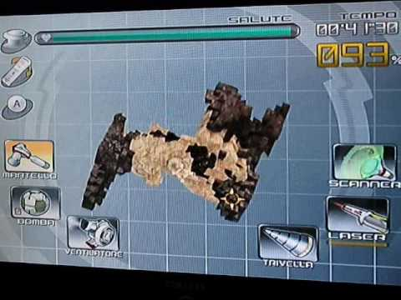
Excavation Mechanic Examples

Slide 5
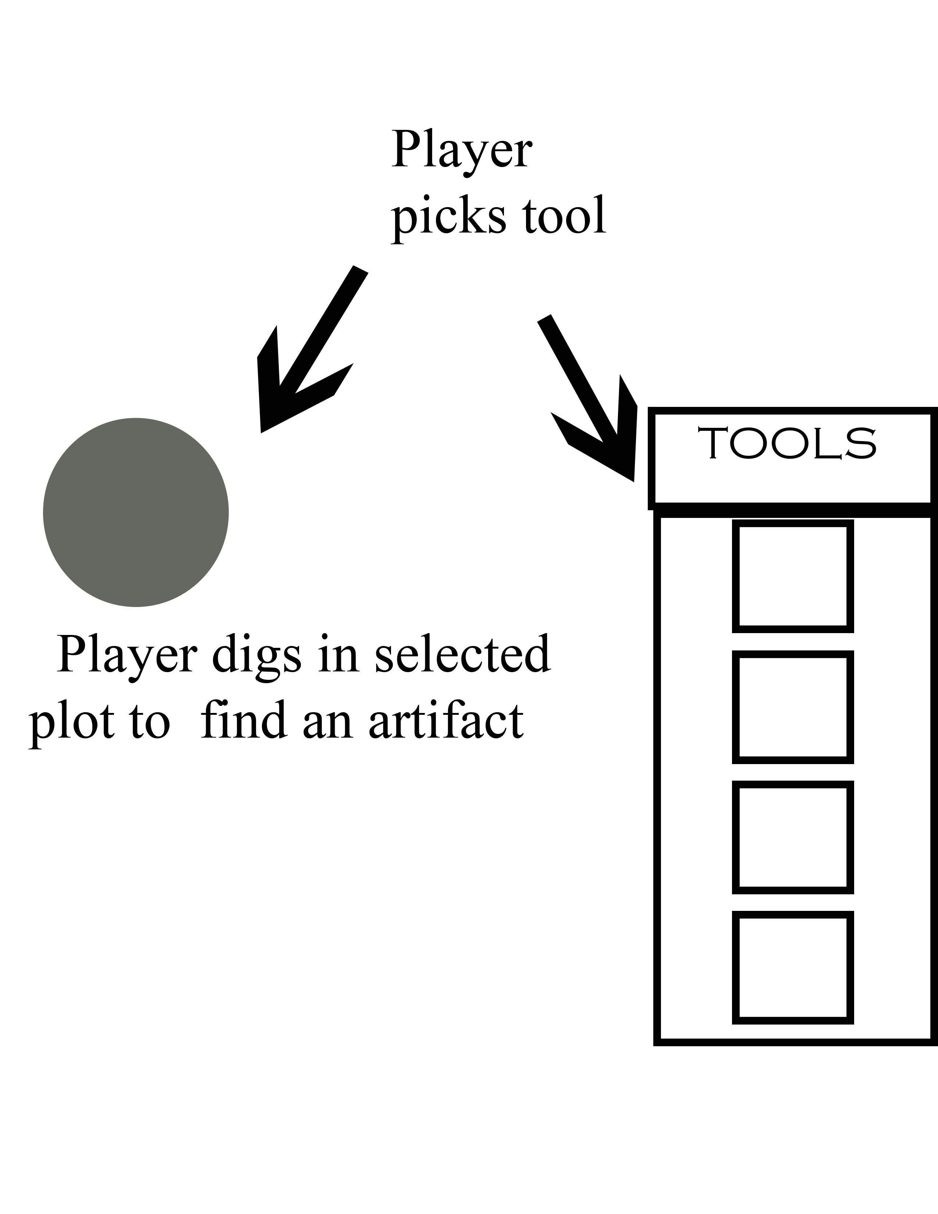
U.I Example

Slide 6
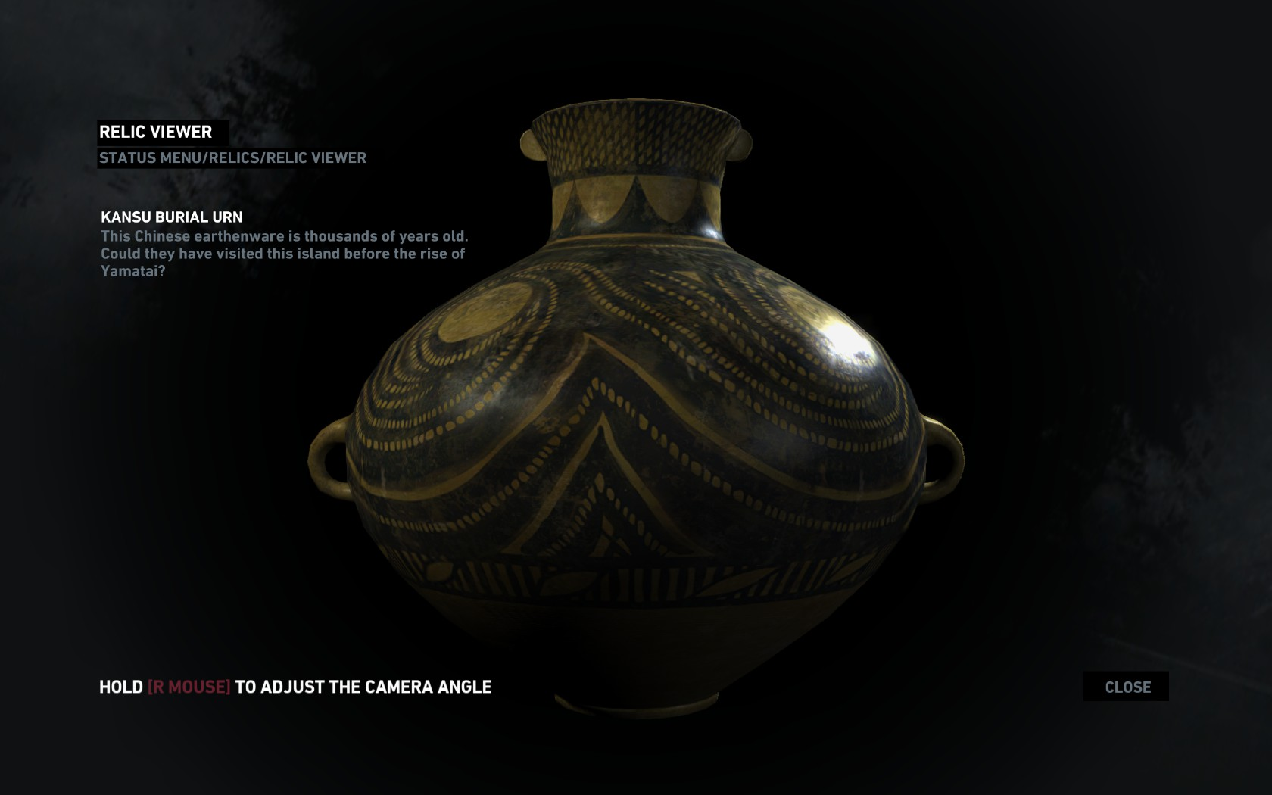
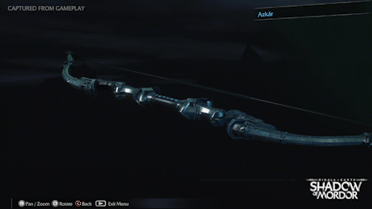
Artefact Analysis Example

Slide 7
Possible Locations
Coliseum – Rome
Machu Picchu – Peru
Pompeii – Italy
Pyramids Of Giza – Egypt
Lake Mundo – Australia
Hemyock Castle – Devon
Stone Henge – Wiltshire
Mount Mulligan – Australia

Slide 8
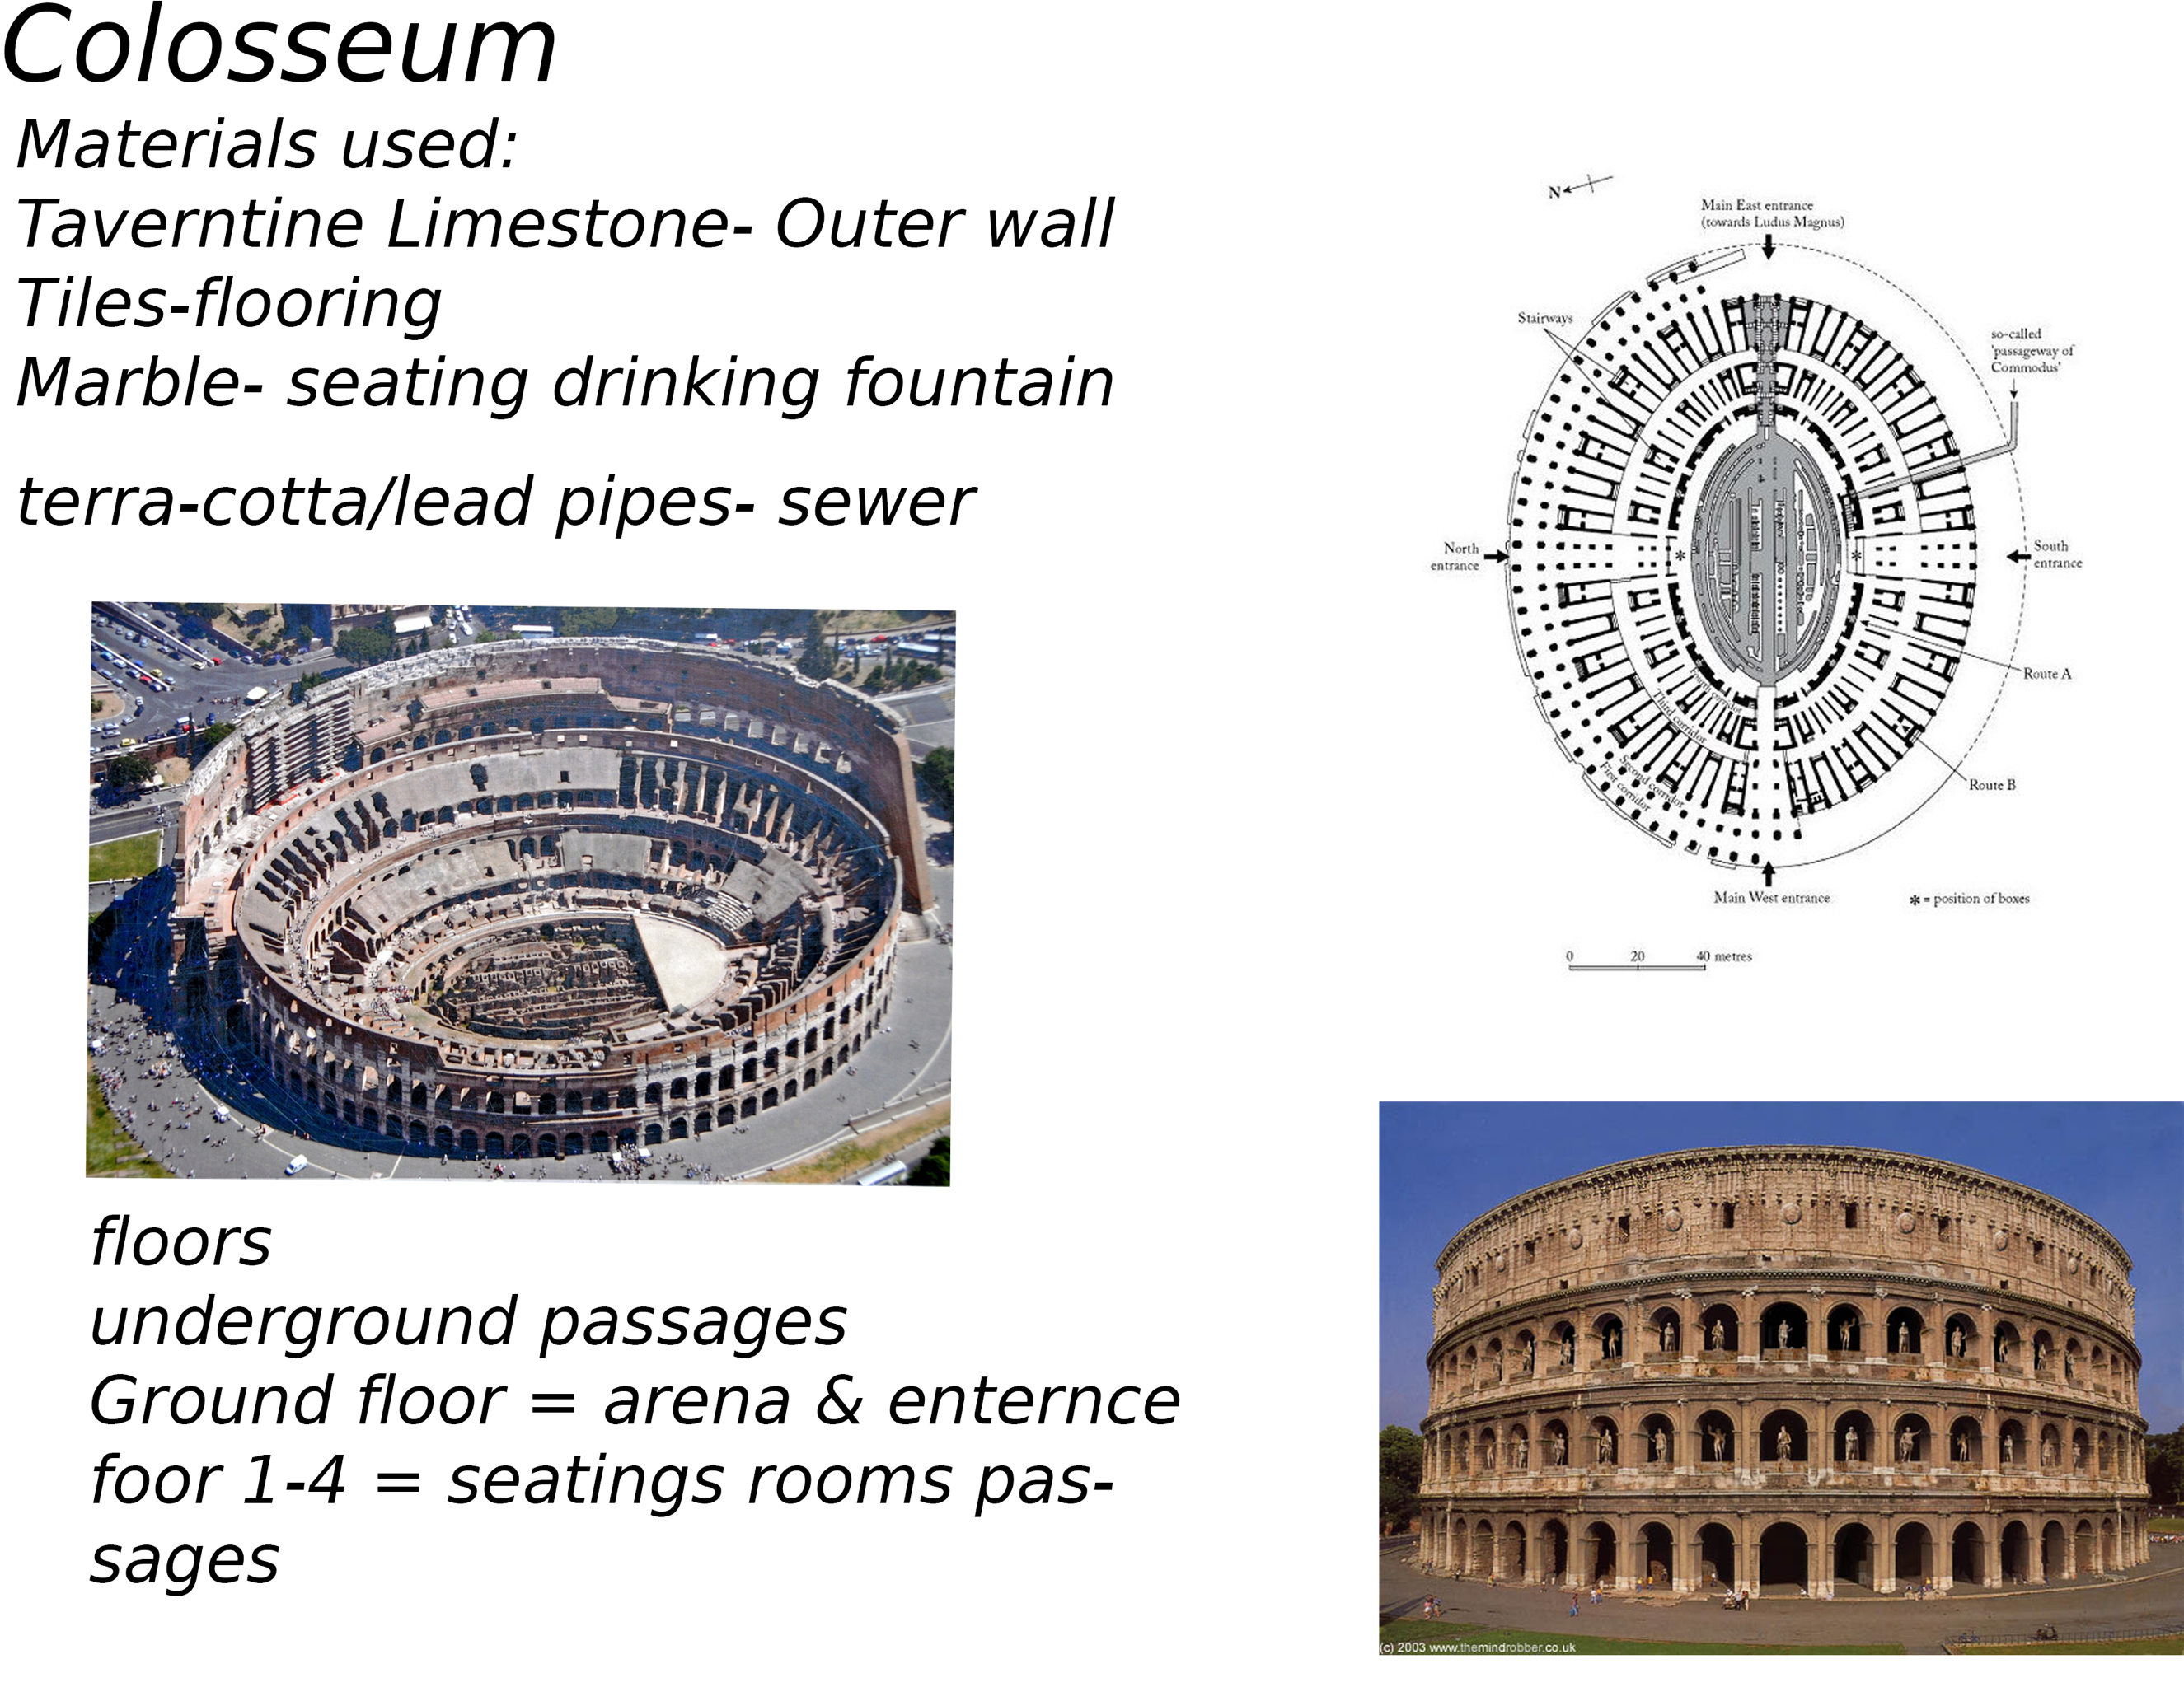

Slide 9
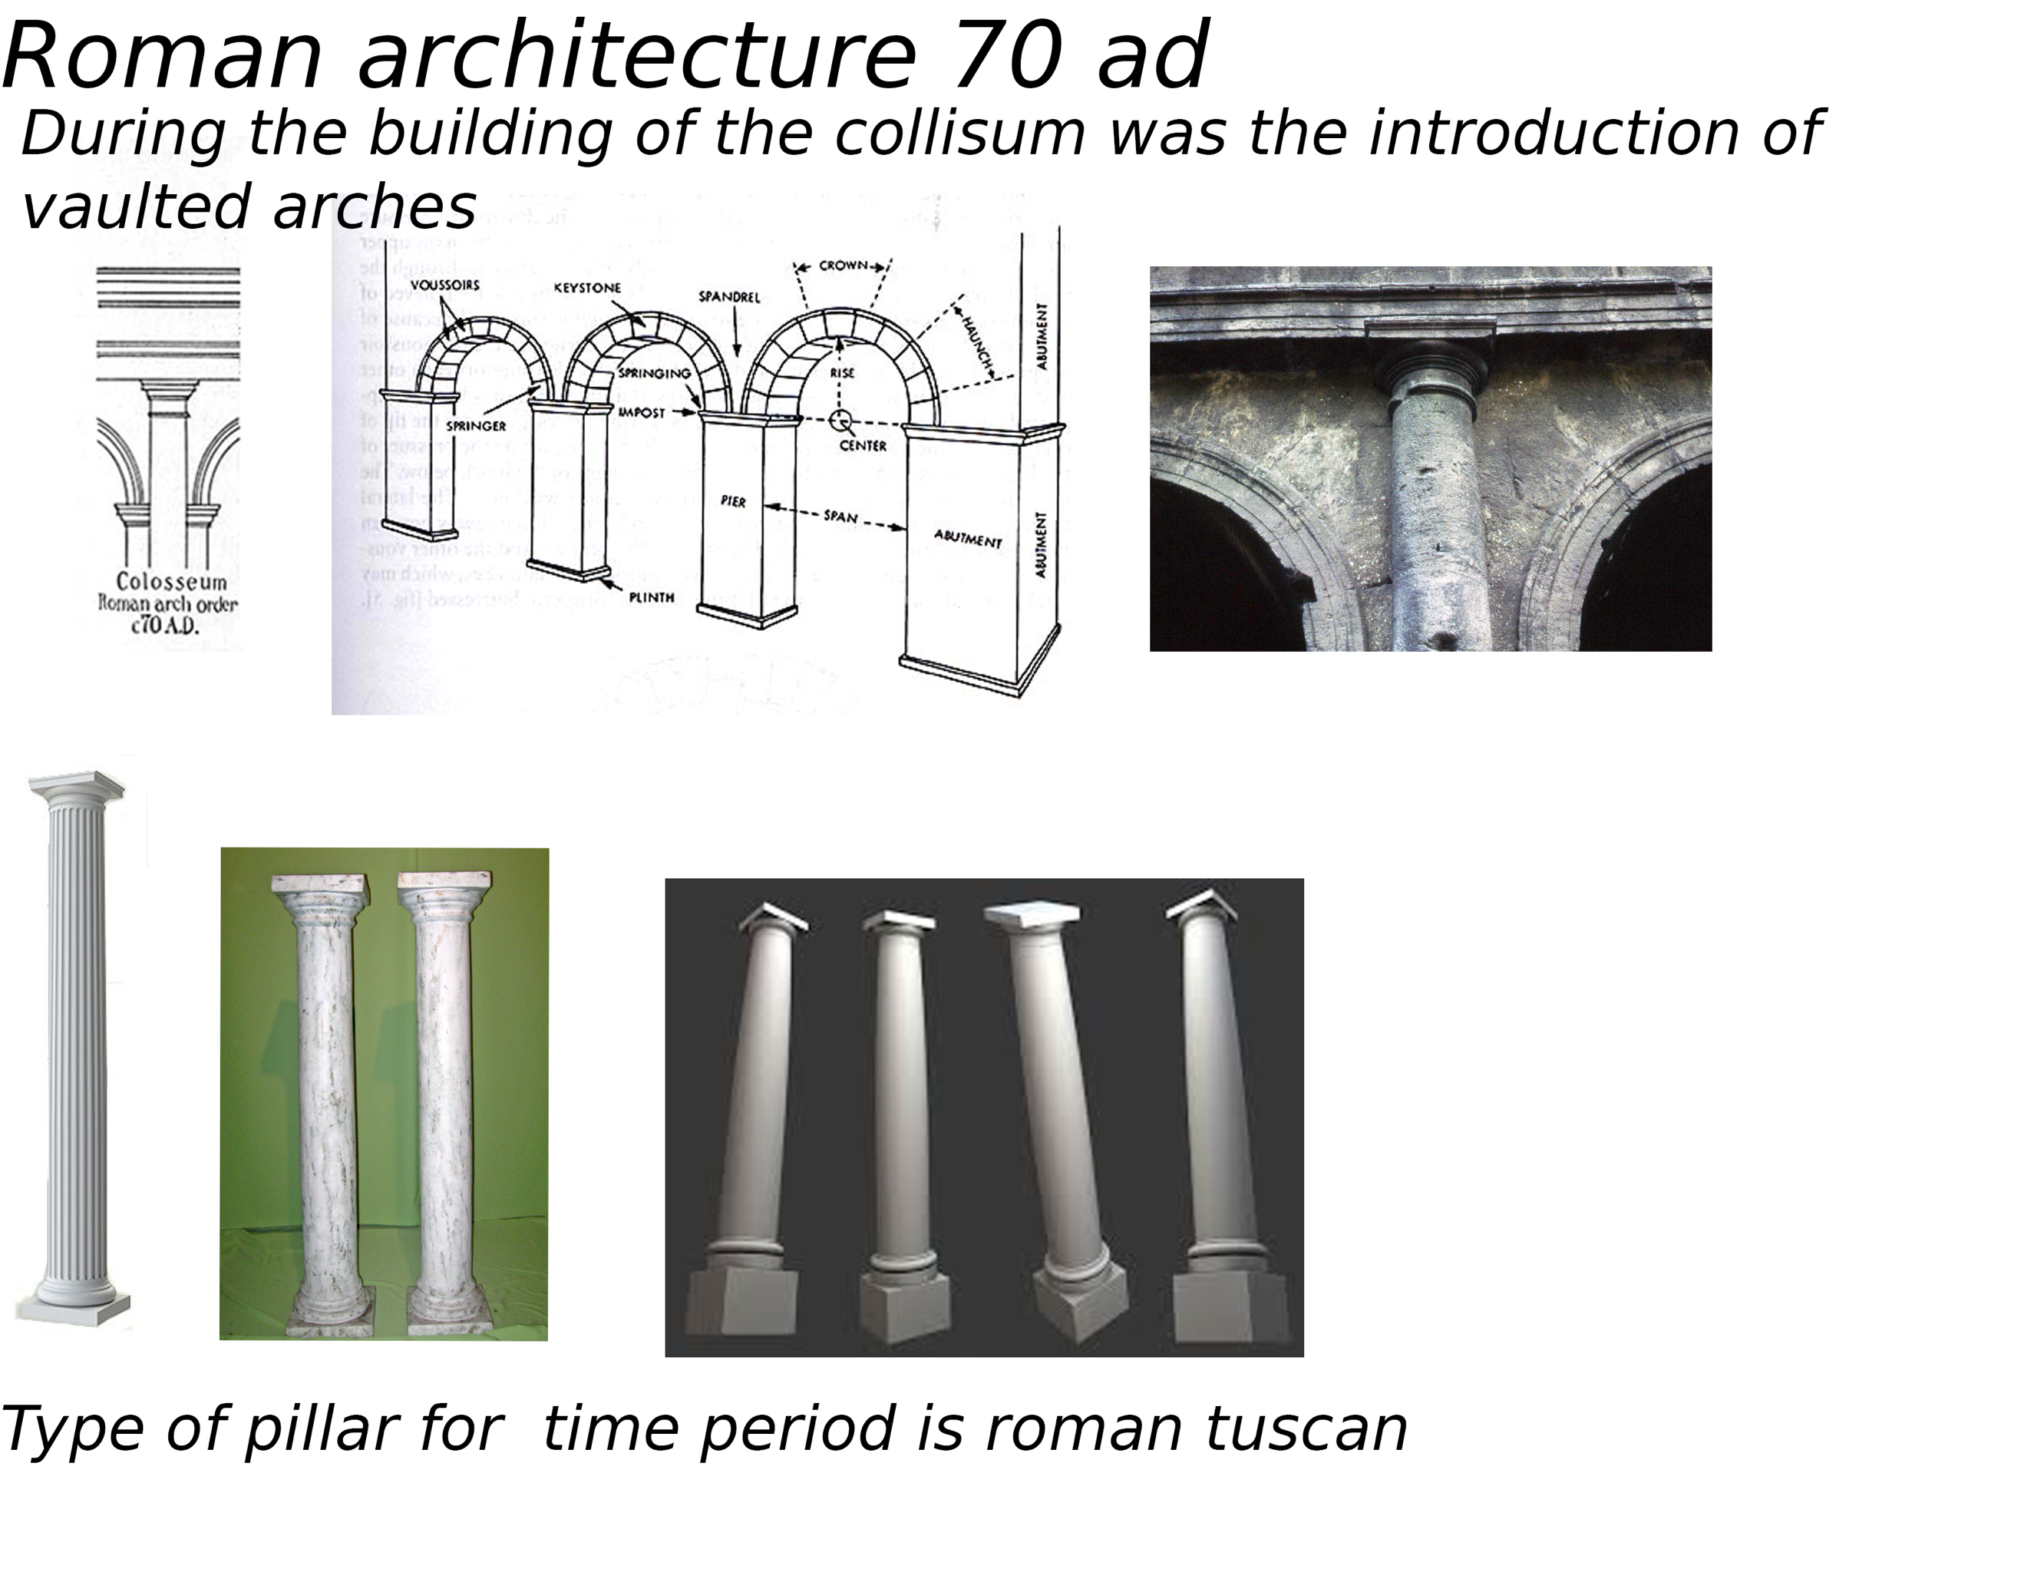

Slide 10
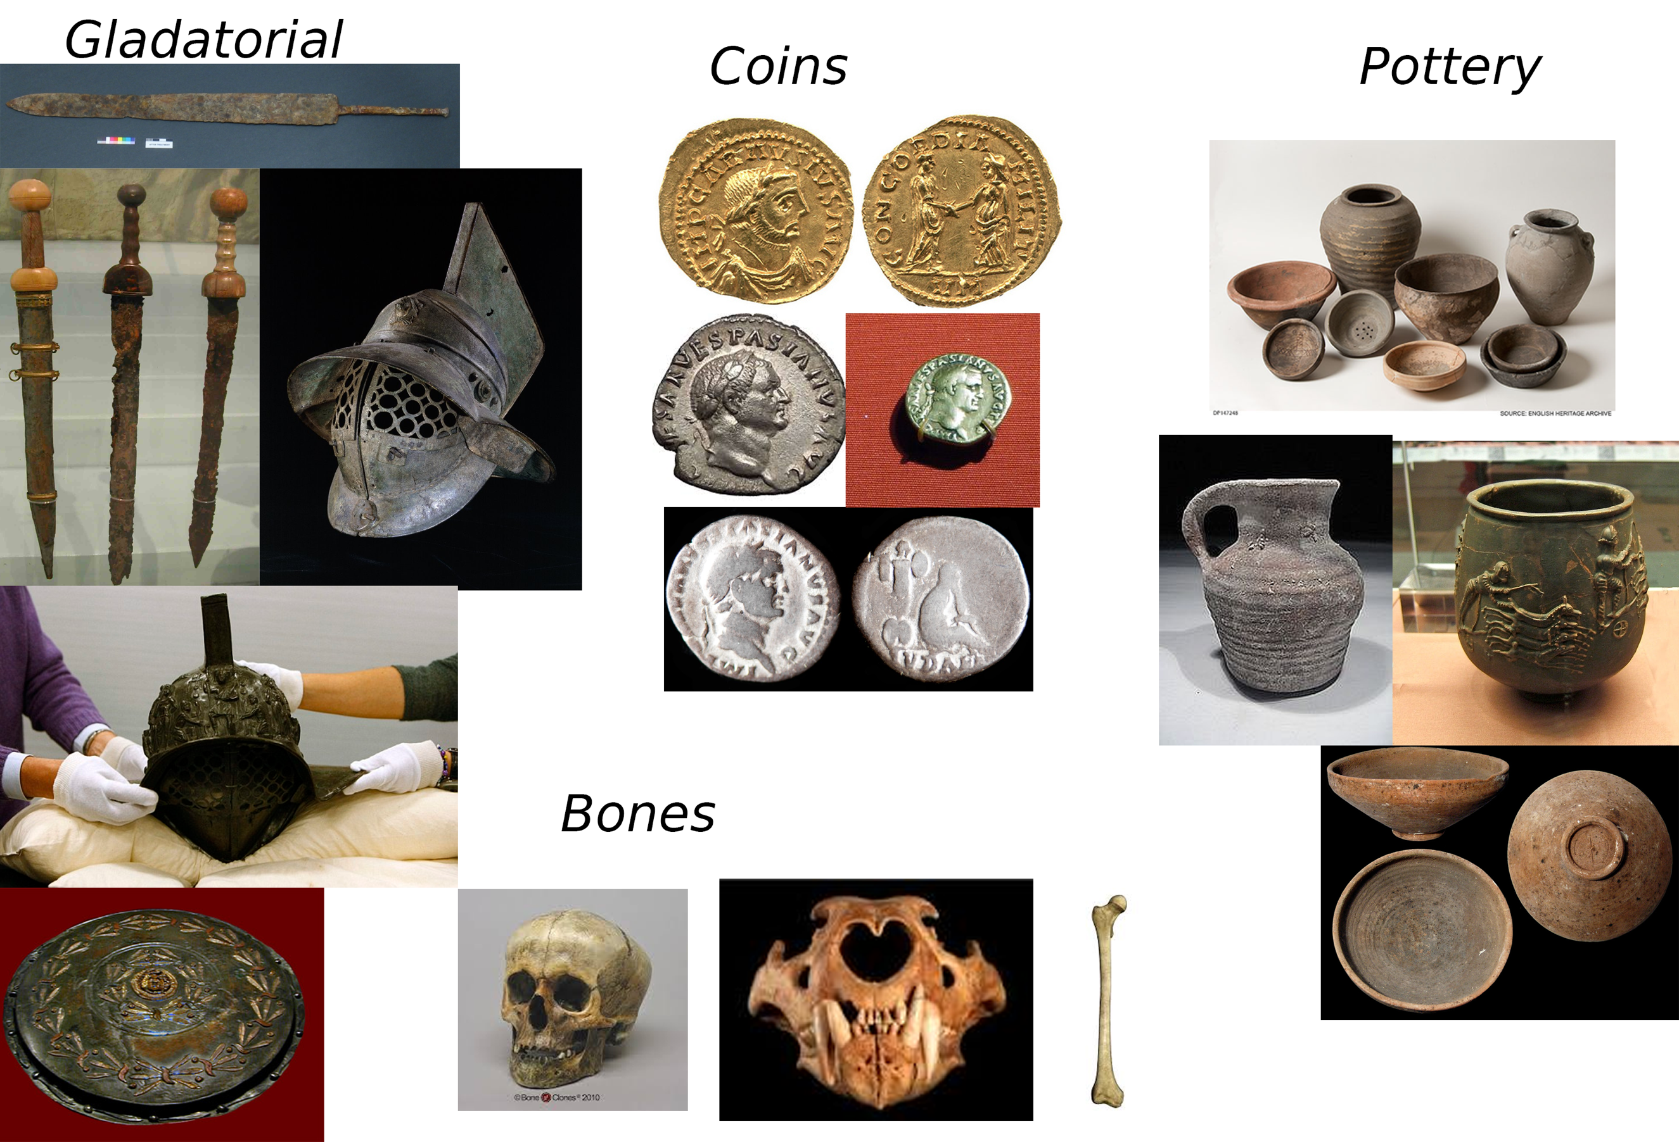
Roman Artefacts

Slide 11
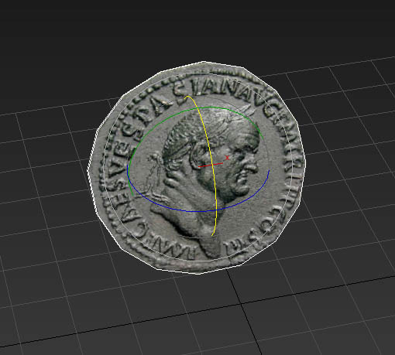
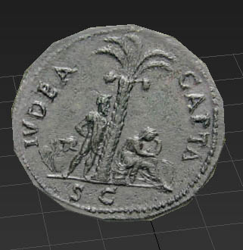
Roman Coin Artefact

Slide 12
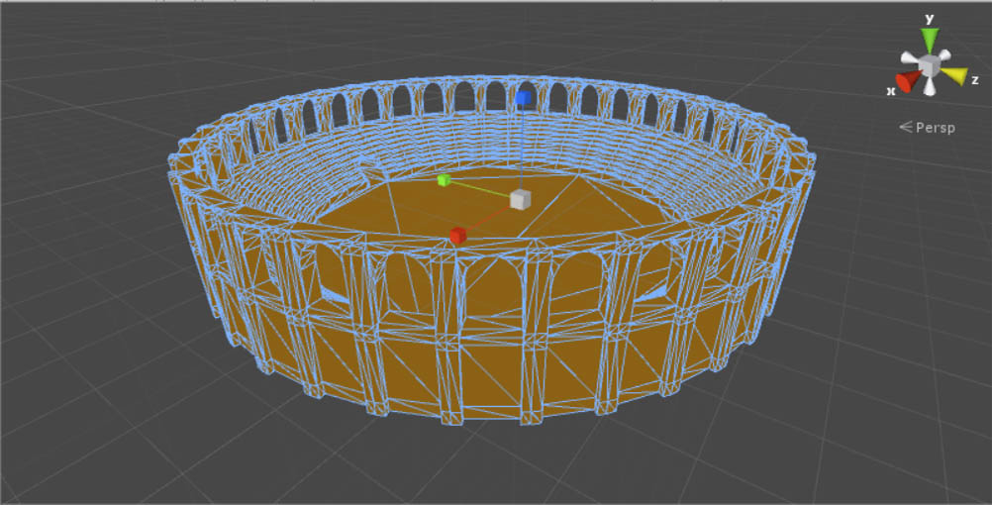
Screenshot from Prototype

Slide 13
Questions

